Slide 1
Program flow
2019-11-13
Göteborg

Slide 2
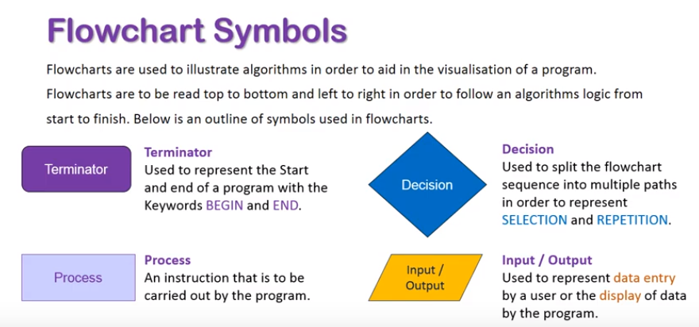
Flow charts
Helps us understand better how the execution of the program is performed.

Slide 3
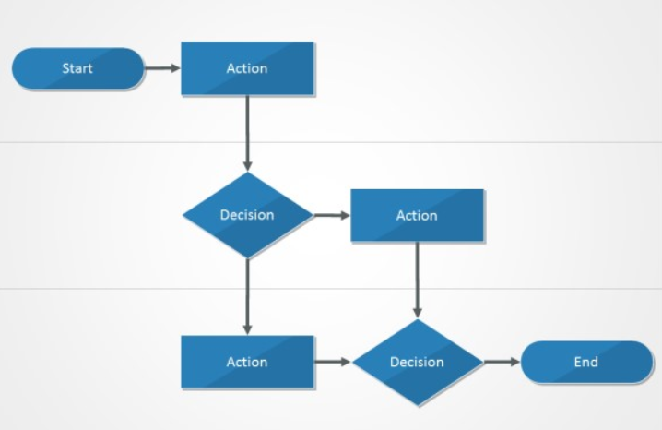
Flow charts
Using arrows, we can visualize the program flow. Action represents here both a Process (some code to be executed) and an Input/Output

Slide 4
Flow charts
The arrows going out from decision show us the different paths our program execution can take.

Slide 5
Flow charts
That decision making can be performed in C# using an if-statement.
We say, if the expression inside is true, then we go one way, otherwise…

Slide 6
Flow charts
We can chose to do nothing, or…
Using an Else statement, we can performa a new branching of the program flow.

Slide 7
Conditional statements
Such as If-else must be evaluated
The result is always TRUE or FALSE.
When we create the condition (the expression to be evaluated), we are using something called comparison operators. The most used comparison operators are:
== (is equal to)
<= (is less then or equal to)
>= (is greater than or equal to)
!= (is not equal to)

Slide 8
Conditional statements
A common mistake made by programmers is to forget that the equality operator requires 2 symbols of ”=”.:
So the correct way to write the condition would be
If (A == B)
{
//do something
}

Slide 9
Conditional statements
Demo time (working with boolean data type and truth tables)

Slide 10
Conditional statements
The Boolean Data Type:
Is declared by the bool keyword
Has two possible values: true and false
Is useful in logical expressions. Our expressions can be found inside:
loops … while (expression) {do stuff}
conditional statements ….if (expression) { do stuff} else {do other stuff}

Slide 11
Conditional statements
Here we can see how boolean variables take values of true or false:
int a = 1;
int b = 2;
bool isGreaterThan = (a > b);
Console.WriteLine(isGreaterThan); // False
bool equalA1 = (a == 1);
Console.WriteLine(equalA1); // True

Slide 12
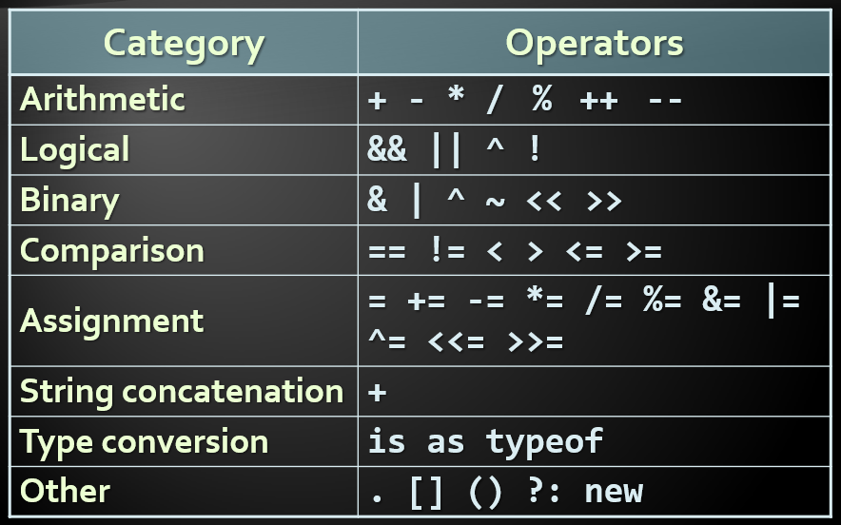
Operators

Slide 13
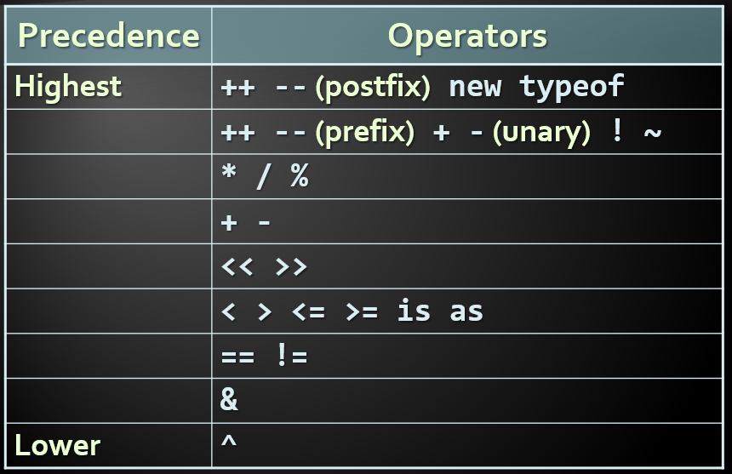
Operator precedence (1/2)

Slide 14
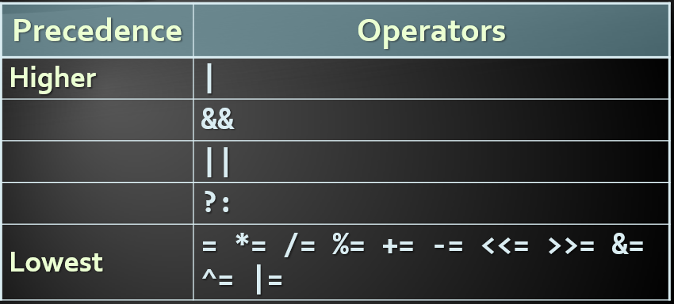
Operator precedence (2/2)
You can and should change precedence using parentheses whenever in doubt:
double result = (4 – 5) / (2 + 6)

Slide 15
Arithmetic operators
Arithmetic operators +, -, * are the same as in math
Division operator / if used on integers returns integer (without rounding)
Remainder operator % returns the remainder from division of integers
The special addition operator ++ increments a variables value by 1.

Slide 16
Arithmetic operators
Arithmetic operators +, -, * are the same as in math
Division operator / if used on integers returns integer (without rounding)
Remainder operator % returns the remainder from division of integers
The special addition operator ++ increments a variables value by 1.

Slide 17
Arithmetic operators - Examples
int squarePerimeter = 17;
double squareSide = squarePerimeter/4.0;
double squareArea = squareSide*squareSide;
Console.WriteLine(squareSide); // 4.25
Console.WriteLine(squareArea); // 18.0625
int a = 5;
int b = 4;
Console.WriteLine( a + b ); // 9
Console.WriteLine( a + b ); // 10
Console.WriteLine( a + (++b) ); // 11
Console.WriteLine( a + b ); // 11
Console.WriteLine(11 / 3); // 3
Console.WriteLine(11 % 3); // 2
Console.WriteLine(12 / 3); // 4

